Slide 1



SAN FRANCISCO BAY UNIVERSITY
CS- 457
Database Implementation for Smooth Drive College of Motoring
Addressing Communication Challenges and Streamlining Operations
PRESENTED BY:
Abu Bakar Siddik(19897)
Tesfaldet Yemaneab (19880)
Simon Gezae(19830)
Zainab Salia(19878)

Slide 2

Overview of Smooth Drive College of Motoring
Multiple offices in strategic cities
Management challenges due to growth and communication issues
1992
Established

Slide 3
Challenges Faced
Growing Number of Students
Inadequate communication across offices
Recruitment of extra administrators
Inadequate communication even within the same city

Slide 4
Director Dave MacLeod Concerns
Improve information sharing and streamline operations
Urgent need for a comprehensive database system

Slide 5


Database Objectives
Store and manage data of administrative staff
Store client information
Store individual lesson, instructor record, car details, and driving test results

Slide 6
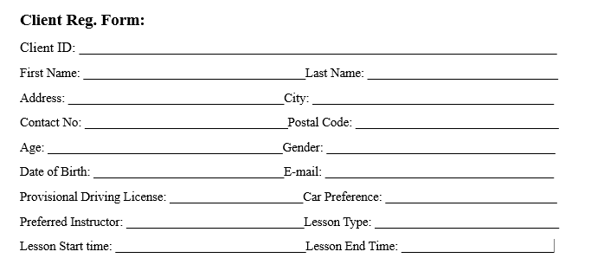
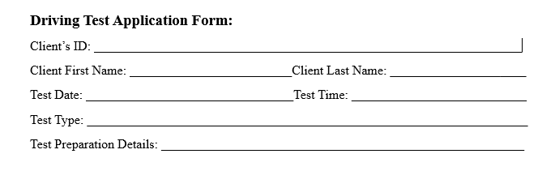
Forms
These forms help us get the information that needs to be stored in the database

Slide 7
Initial Assumptions
Instructors are assigned to cars and clients according to the clients' choices and availability.
Clients should do proper practice with an instructor. And an instructor will guide the client accordingly.
Clients are responsible for applying for driving tests when they are ready.
Test results are recorded by an external testing center.
Instructors are responsible for preparing clients for both the written and practical parts of the driving test.
Each office has staff members with specific roles, such as Managers, Instructors, and administrative staff.
Clients need to make sure that the information they are providing is accurate.
As clients are sharing their personal information, the company will make sure that their system is safe enough.
After the test, the test report should be recorded no matter whether they pass or fail.

Slide 8
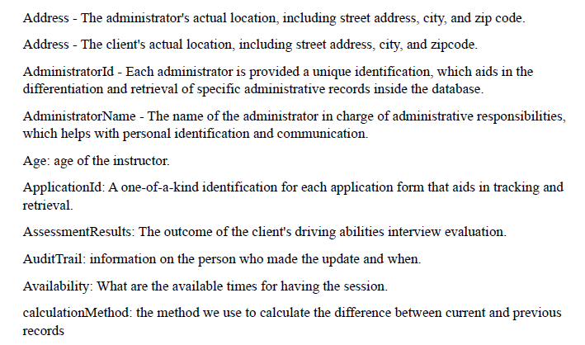
Data Dictionary
A user manual for your data, helping you understand and use it effectively.

Slide 9
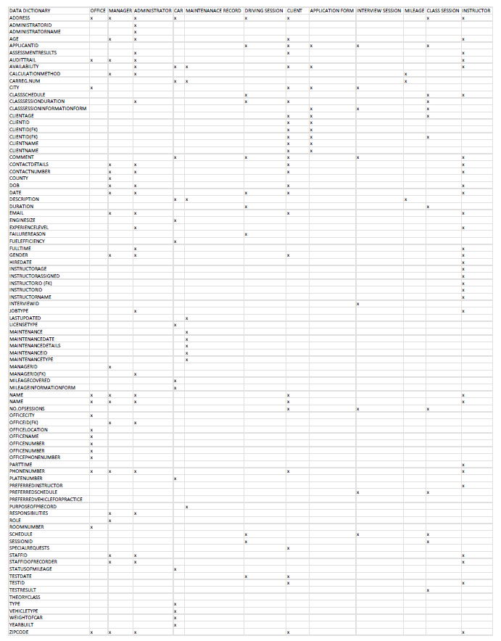
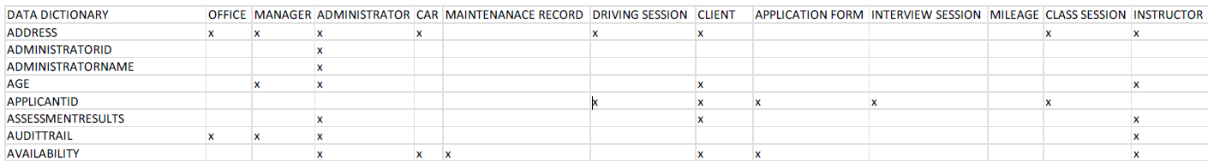
Cross Reference Table
A special table joins other tables together by storing the connections between their data

Slide 10
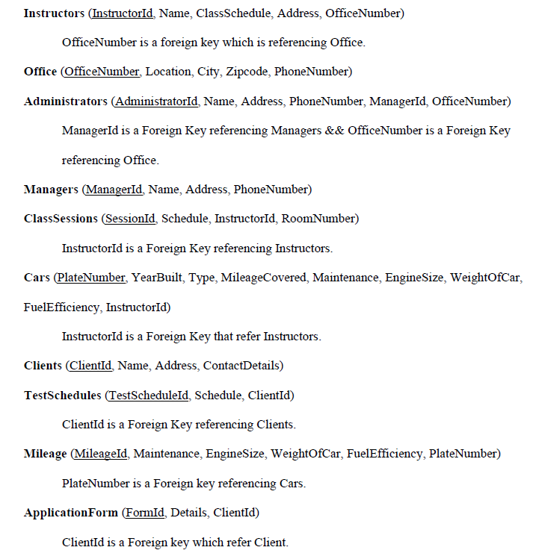
Identifying Entities and Attributes
Entities and attributes are the building blocks of data organization in databases. They act as the foundation for storing and managing information efficiently and accurately.

Slide 11
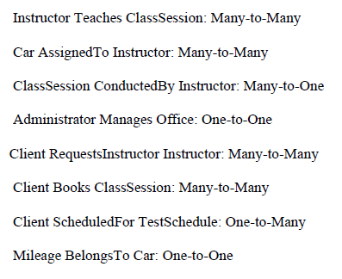
Relationships
Relationships act as bridges between different data entities, enabling you to seamlessly retrieve and analyze information in a way that reveals its true meaning and significance.
One - to - One (1:1)
One - to - Many (1:M)
Many - to - Many (M:M)

Slide 12
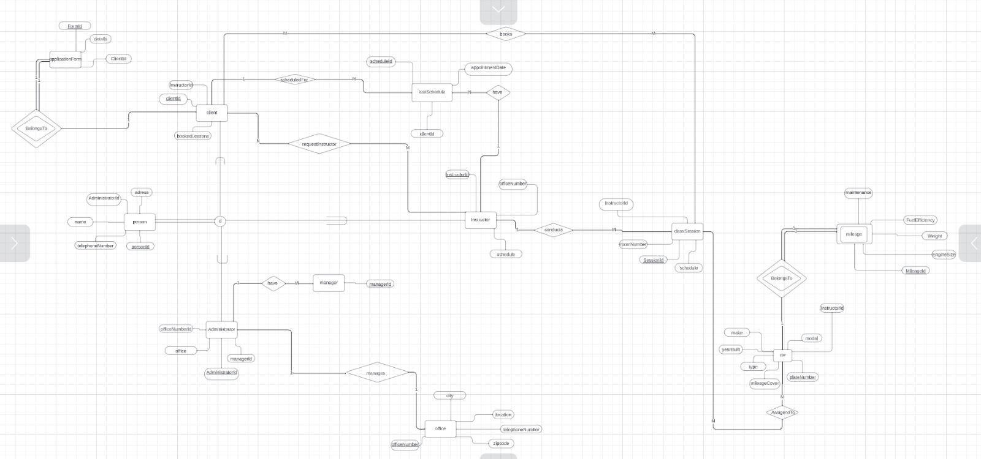
ER Diagram
An ERD acts like a map of your database, showing you all the key elements and how they connect. It's a valuable tool for organizing your data, making it easier to understand and manage.

Slide 13
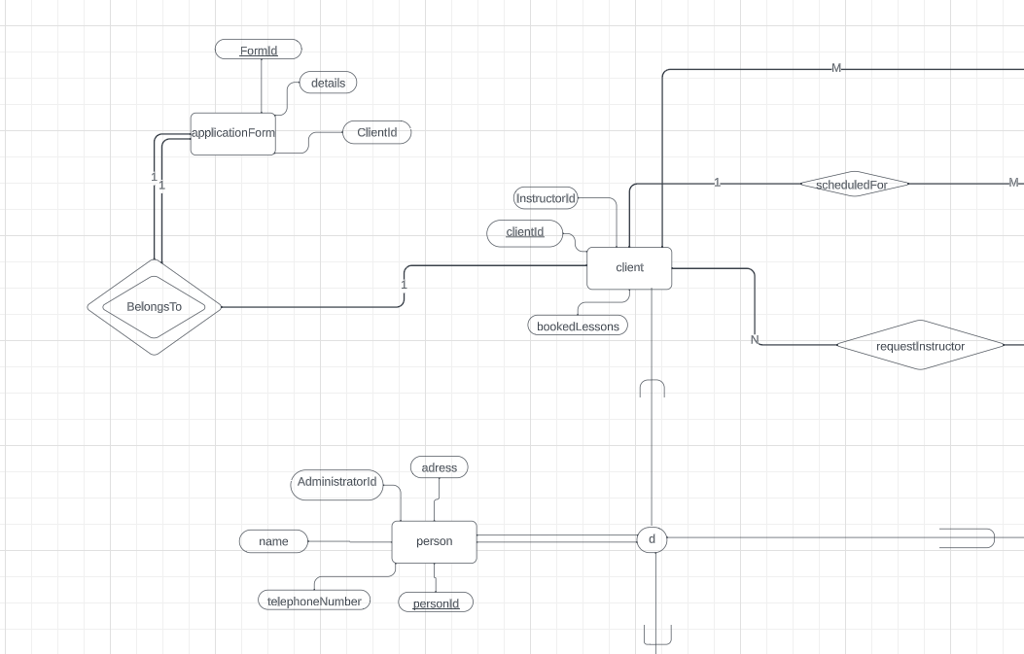
ER Diagram
An ERD acts like a map of your database, showing you all the key elements and how they connect. It's a valuable tool for organizing your data, making it easier to understand and manage.

Slide 14
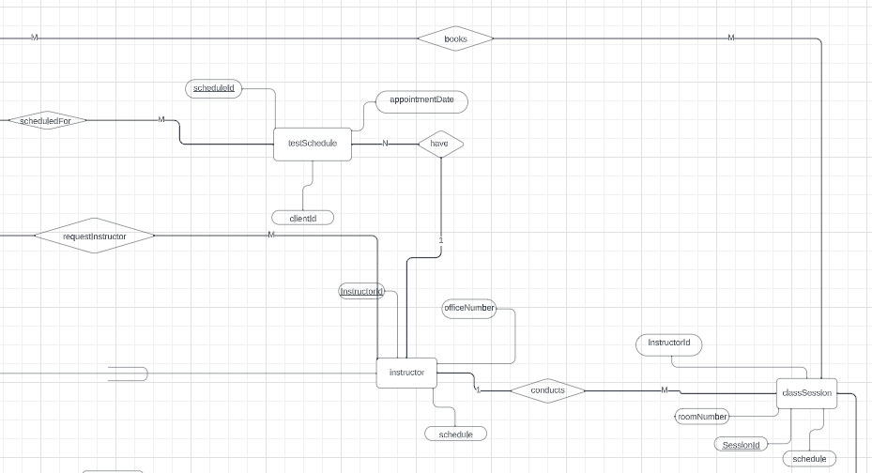
ER Diagram
An ERD acts like a map of your database, showing you all the key elements and how they connect. It's a valuable tool for organizing your data, making it easier to understand and manage.

Slide 15
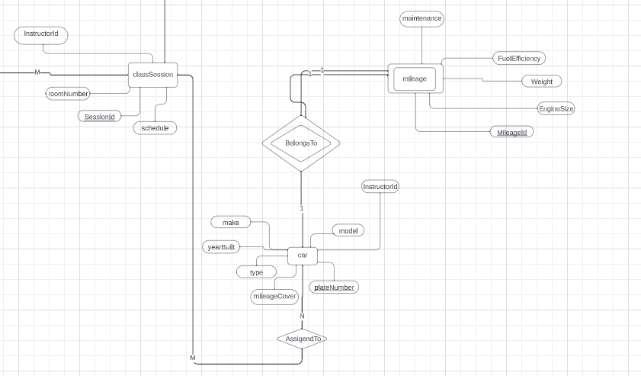
ER Diagram
An ERD acts like a map of your database, showing you all the key elements and how they connect. It's a valuable tool for organizing your data, making it easier to understand and manage.

Slide 16
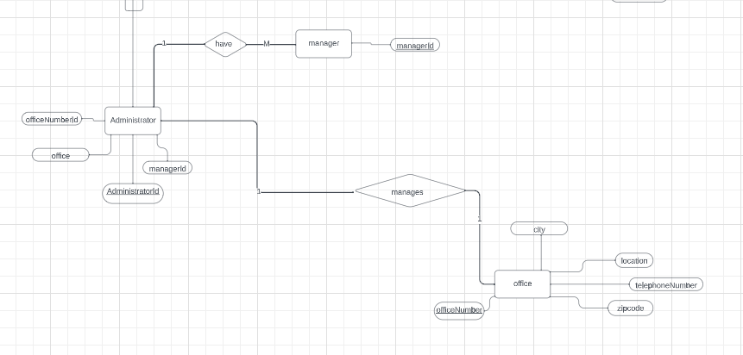
ER Diagram
An ERD acts like a map of your database, showing you all the key elements and how they connect. It's a valuable tool for organizing your data, making it easier to understand and manage.

Slide 17
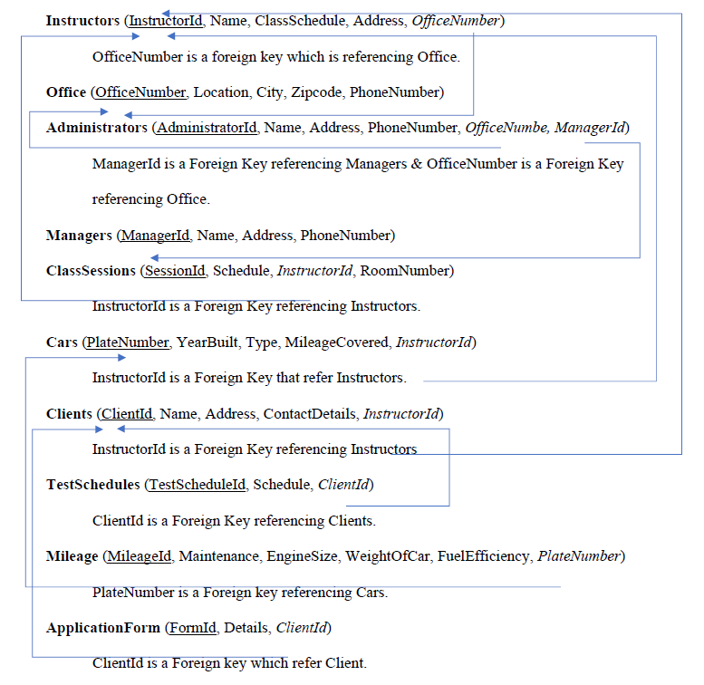
Schema
A database schema is the blueprint that defines how data is organized and stored within a database.
It acts like a set of rules and guidelines that govern the structure of the database

Slide 18
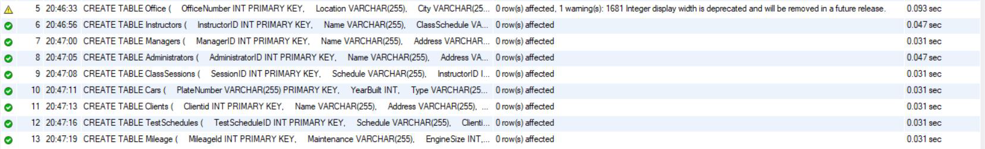
Creating Tables
CREATE TABLE ClassSessions (
SessionID INT PRIMARY KEY,
Schedule VARCHAR(255),
InstructorID INT,
FOREIGN KEY (InstructorID) REFERENCES Instructors(InstructorID),
RoomNumber VARCHAR(255)
);
CREATE TABLE Cars (
PlateNumber VARCHAR(255) PRIMARY KEY,
YearBuilt INT,
Type VARCHAR(255),
MileageCovered INT,
InstructorID INT,
FOREIGN KEY (InstructorID) REFERENCES Instructors(InstructorID)
);
CREATE TABLE Office (
OfficeNumber INT PRIMARY KEY,
Location VARCHAR(255),
City VARCHAR(255),
Zipcode INT(5),
PhoneNumber VARCHAR(20)
);

Slide 19
Populating the Tables
INSERT INTO Office (OfficeNumber, Location, City, Zipcode, PhoneNumber)
VALUES
(1, 'Main Office', 'Cityscape', 89923, '787-878-3333'),
(2, 'Branch Office', 'Markshire', 67890, '987-654-3210'),
(3, 'Another Branch Office', 'Mark', 67990, '917-654-3211'),
(4, 'Main Office', 'Cityscape', 45039, '990-989-2343'),
(5, 'Main Office', 'New City', 76767, '982-233-2433'),
(6, 'Branch Office', 'Marskhire', 78278,'565-959-9633'),
(7, 'Tech Park Office', 'Tech City', 76543, '777-777-7777'),
(8, 'Industrial Office', 'Industry Town', 87654, '888-888-8888'),
(9, 'Rural Office', 'Countryside', 34567, '999-999-9999'),
(10, 'Harbor Office', 'Harbor City', 23456, '000-000-0000');

Slide 20
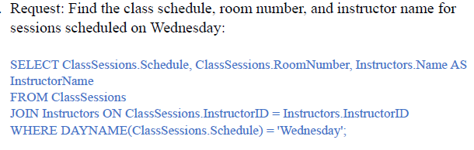
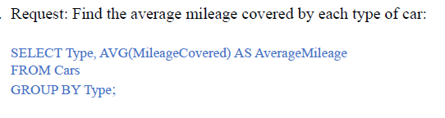
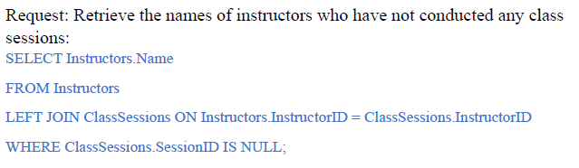
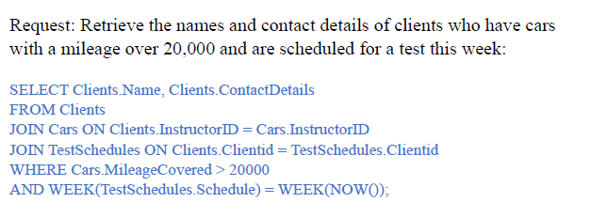
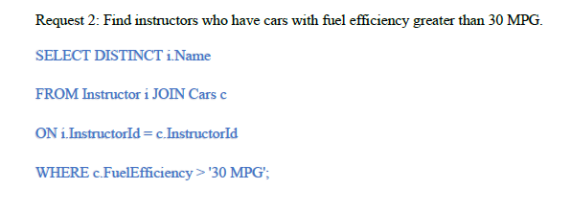
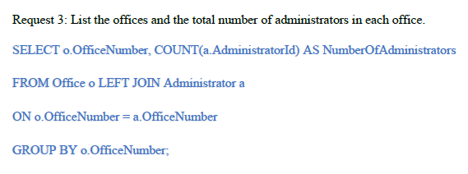
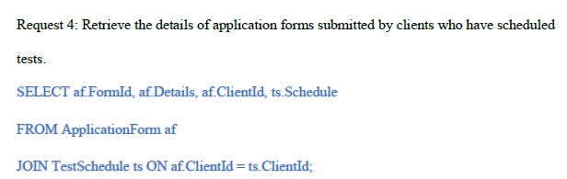
Non Routine Requests

Slide 21
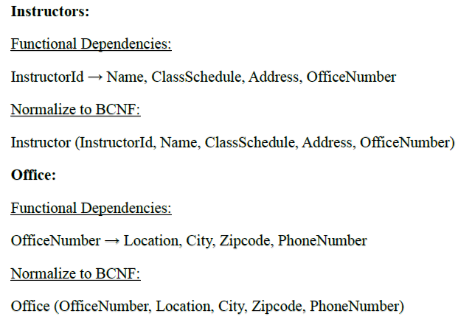
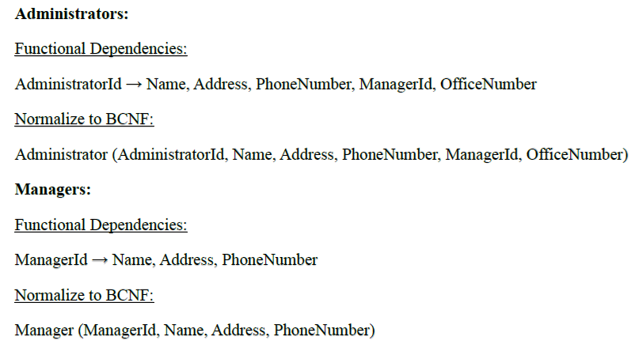
Normalization
Normalization in DBMS acts like a data organizer, getting rid of duplicate information and ensuring that all data is accurate and consistent.
This creates a more efficient and reliable database, saving space and minimizing errors.

Slide 22
Levels of Normalization
1st Normal Form (1NF) -
Ensures data is organized in simple, flat tables with no repeating groups.
Guarantees each cell in the table contains a single, indivisible value.
Eliminates duplicated data within a table.
2nd Normal Form (2NF) -
Satisfies all requirements of the first normal form.
Eliminates situations where non-key attributes depend only on a portion of the primary key.
Ensures updates to the primary key are reflected consistently across the entire table.
3rd Normal Form (3NF) -
Meets all conditions of the second normal form.
Eliminates instances where non-key attributes rely on other non-key attributes.
Minimizes data duplication and optimizes data access and manipulation.
Boyce-Codd Normal Form (BCNF) -
Imposes even stricter rules than the third normal form.
Eliminates all dependencies except for those based on the primary key.
Requires a more complex structure but offers maximum data integrity and efficiency.

Slide 23
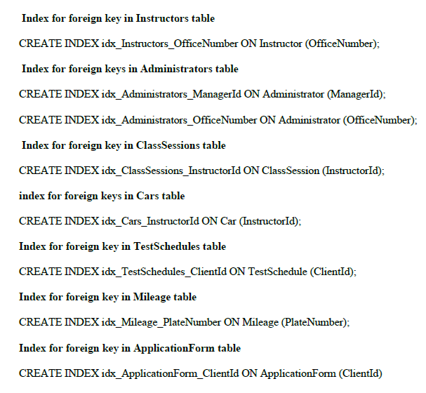
Indexing
Indexing acts like a super-fast directory for your database. By building a separate map of specific data items, it helps the system quickly find what you're looking for, making queries run much smoother and faster.

Slide 24
Expected Outcomes
improved database management system
Addressing current inefficiencies
More efficient storage and management of information
Enhancing operations and client services

Slide 25
Conclusion
The Smooth Drive College of Motoring successfully implemented a new database system, culminating in a robust platform for data storage and management.
The project achieved key objectives, including well-structured data modeling, efficient database design, and seamless implementation.
This new system promises improved communication, streamlined operations, and efficient data management, ultimately leading to enhanced services for clients. The team's dedication is acknowledged for their pivotal roles in this successful undertaking.
By fostering ongoing collaboration and continuous optimization, Smooth Drive College of Motoring paves the way for future growth and success.

Slide 26
Questions?

